Slide 1
Affordable Housing
Action Alternatives
for creating attainable housing at
the local level
Connecticut Federation of Planning and Zoning Agencies
Hiram Peck, AICP, CFM
April 30, 2020

Slide 2
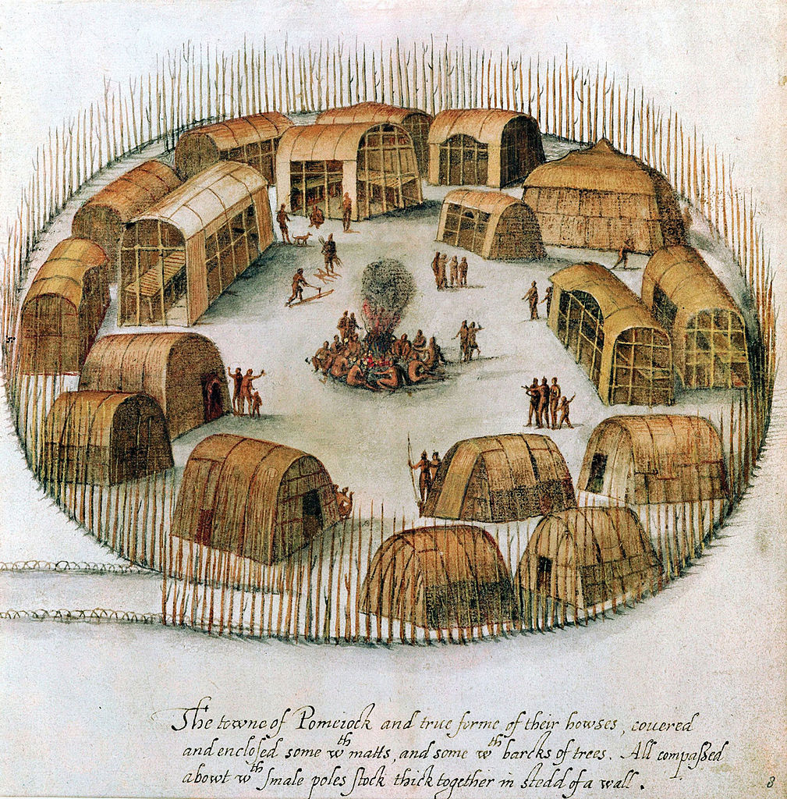
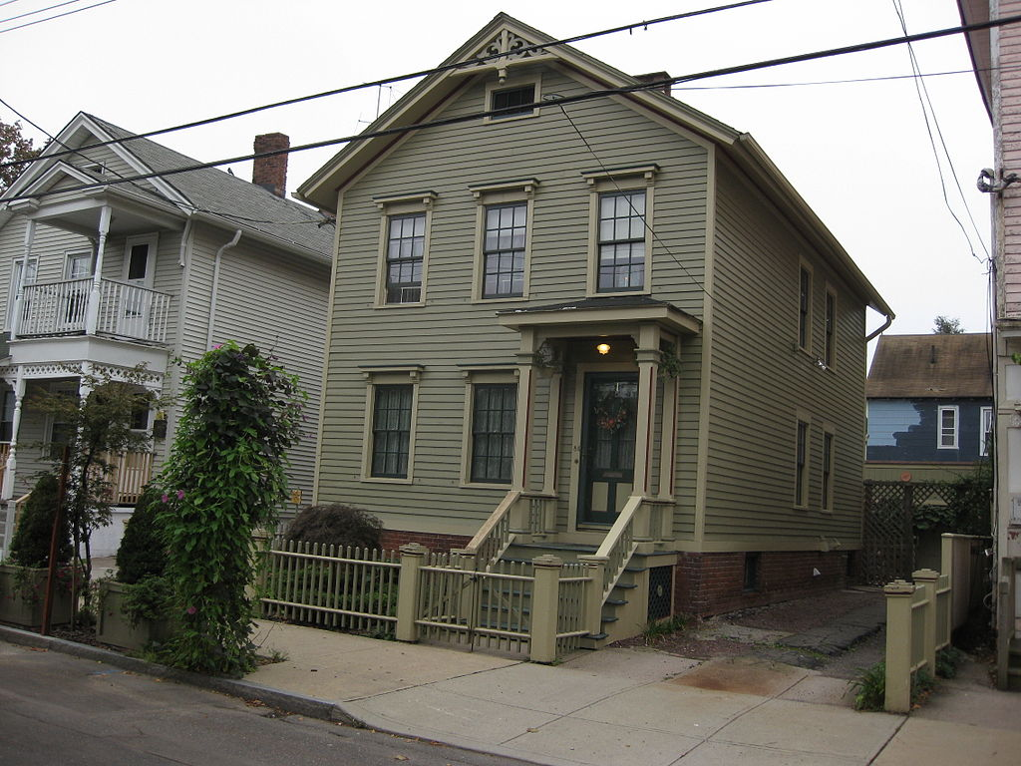
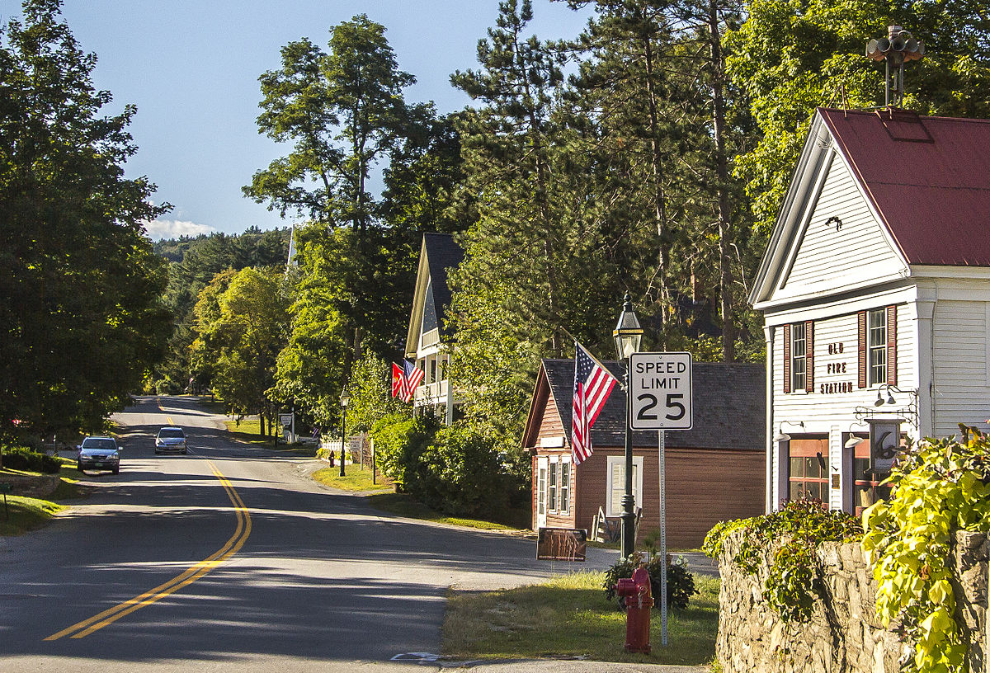

Slide 3
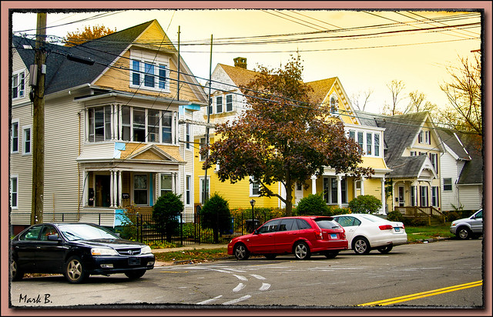
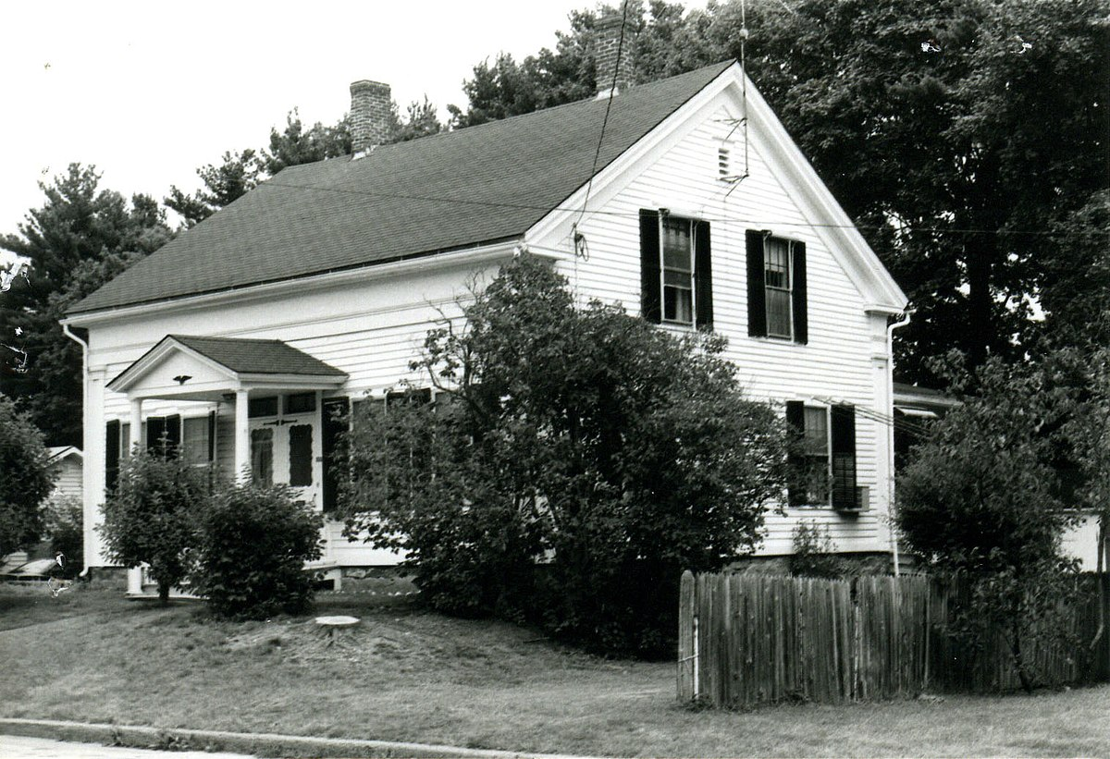
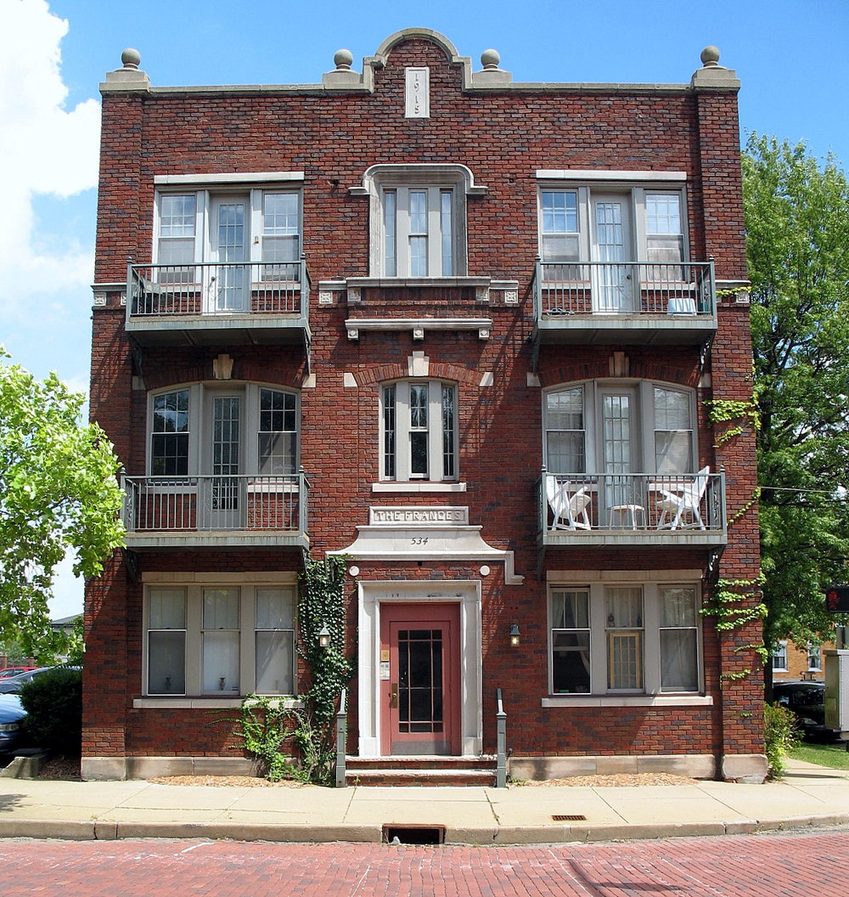

Slide 4
Alternatives
What are the available alternatives?
Several available to choose.
Criteria?
What is needed? Local leadership and knowledge
What is the desired result?
Where do we go from here?

Slide 5
CGS 8-30g.
Legislation passed in 1990 by CT Legislature due to the significant need for affordable housing.
Sets a goal of 10% of local housing stock to be designated as affordable in each municipality.
Until the 10% goal is reached, municipality remains subject to CGS 8-30g.
Moratorium may be applied for if certain number of affordable units is reached.

Slide 6
CGS 8-30g
Requires that the 30% of the dwelling units/apartments be: 1. assisted housing, or 2. a set aside development, where,
15% of the units are sold/leased or rented at 60% of the area median income (ami) and 15% are sold/leased or rented at 80% of the ami or the CT State Median income whichever is less.

Slide 7
What is affordable/attainable housing?
Statutory Definition: CGS §8-39a.… “housing for which persons and families pay 30% or less of their annual income, where such income is less than or equal to the area median income for the municipality in which such housing is located, as determined by US Dept. of Housing and Urban Development.
What does affordable housing mean to you?
Why should you care?
As a Commission member?
As a business owner?
As a taxpayer?
As a member of your community why should you care?

Slide 9
Median Household Income:*
Fairfield County: $92,969
Hartford County: $72,321
Litchfield County: $78,314
Middlesex County: $84,761
New Haven County: $67,128
New London County: $71,368
Tolland County: $84,916
Windham County: $64,774
Connecticut: $77,068
*Source: American Community Survey 2018

Slide 10
What do you think of affordable housing in your community?
Frequent responses, which all bear research:
Too dense, does not fit into neighborhood
Drain on school system ($)
Change in “community character”
Negative traffic impact
No sewers, we can’t do it
Adverse impact on property values
Adverse impact on environmental resources
Not safe….

Slide 11
Lets look at economic development:
What is the potential impact on economic development of affordable housing in your community? Per 100 affordable units:*
Construction: $14.5 million in ec activity
$2.3 million in state/local taxes
165 jobs
Each year after:$3.8 million in ec activity
$1.1 million in state/local taxes
42 Jobs
$7,000 in disposable income/ for local spending
*Source:Partnership for Strong Communities, CT Dept. of Housing and NAHB

Slide 12
Keys to attainable housing acceptability:
Design for the context.
Educate all involved through the process.
Be accurate in your inquiries and answers both from the public and from applicants.
Be creative and realistic throughout the process.
Design, design and design to upgrade the area.

Slide 13
Some options to consider:
“Friendly” Affordable Housing, CGS 8-30g,
HOME Connecticut 2008, CGS 8-13m et. seq.
Incentive Housing Zones
Inclusionary Zoning, CGS 8-2g. (Density increases)
- Fee in lieu of affordable housing
Village District Zoning, CGS 8-2j. (Variety of types)
Design Districts, Form Based Coding, or CoHousing.

Slide 14
Incentive Housing Zones (IHZ):
Why consider this?
Provides significant flexibility in many areas
Allows more municipal control of the process
Possible developer buy in as a time/$ saving alternative with possible better result.
Attainable units, properly documented, count toward 10% goal. (20% required)
(Originally $$ to community. Not likely at present.)

Slide 15
What specifics might apply?
Architectural variation of buildings and units.
Scale and proportion
Typical bulk standards
Types of development proposed:
TOD type development
Village Center
Commercial area
Local determination as to location. (POCD?)

Slide 16
Advantages of such zoning:
Renewed vigor in Connecticut municipalities.
Revitalize a stagnant development atmosphere in some municipalities.
Provides for inclusive planning with more equity for all community members.
Provide for more vital communities in the future serving all age groups.
Others include grand list growth and…

Slide 17
Disadvantages of not planning:
Surprise applications with little Commission input. Public concern.
Possible CGS 8-30g applications with unacceptable types of development.
Possible court expenditures for litigation which is likely to be lost.
Sets up or continues an atmosphere of conflict as opposed to one of cooperation.

Slide 18
Some options to consider:
“Friendly” Affordable Housing, CGS 8-30g,
HOME Connecticut 2008, CGS 8-13m et. seq.
Incentive Housing Zones
Inclusionary Zoning, CGS 8-2g. (Density increases)
- Fee in lieu of affordable housing
Village District Zoning, CGS 8-2j. (Variety of types)
Design Districts, Form Based Coding, or CoHousing.

Slide 19
Special District Zoning:
Village Districts:
Creation/revitalization of Village Centers
Rehabilitation of existing buildings
Form Based Coding:
Specific area form creation
Allows creation of areas not allowed by current zoning
CoHousing: Creation of multigenerational, clustered housing. Possible open space adds.
Unlimited creativity…

Slide 20
Why consider attainable housing?
CGS 8-2 requires it.
Local Affordable Housing Plans are now required by statute.
Plan ahead rather than be surprised.
Consider, what does your town need to be a vital, active, and dynamic place with equity for all income levels?

Slide 21
Now, a few questions:
What issues does your commission have with affordable housing applications?
What are the most significant problems your town has at this time?
Do you believe there are any connections between housing supply and other local problems?
If you community is involved with Sustainable CT does it have a housing component?

Slide 22
Thankyou!
Please feel free to send me any questions you wish.
Hiram Peck, AICP, CFM
hpeck@avonct.gov

